Slide 1

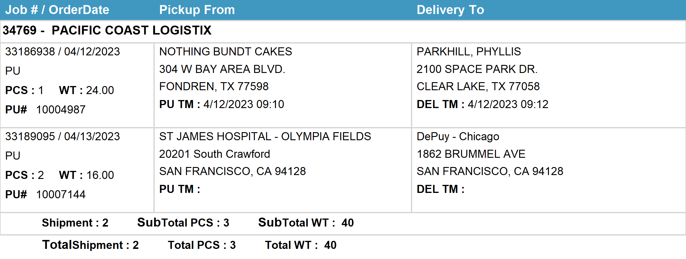
Agent Activity Report
*Data provided should be considered CONFIDENTIAL and PROPRIETARY*
©2011-2023 MNX Global Logistics. All rights reserved.
4/17/2023 11:39 PM
Print User : selenium.automation

